Slide 1


Slide 2

“The ABC quiz”

Slide 3
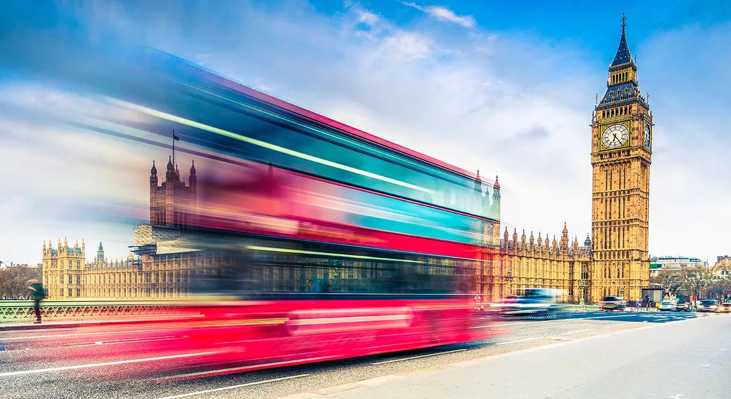
Speaking letters

Slide 4

“Taking steps”

Slide 5

“What colour is it?”

Slide 6
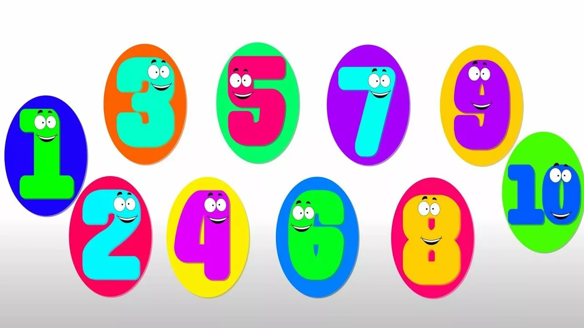
“Find the number”

Slide 7


